Slide 1
FIU-SCIS-Senior-Projects Addigy4
Carlos Ruiz - Developer
David Romero - Developer
Jason Dettbarn - Mentor
Javier Carmona - Mentor
Ayme Morrina - Mentor
Masoud Sadjadi - Instructor
Notes:
FIU-SCIS-Senior-Projects

Slide 2
Problem Definition
Tunneler:
Creating a remote control session is complicated for users
It is not practical for users moving around
Almost impossible for users with no technical experience
Pubsub:
Sending messages to multiple devices can prove to be cumbersome
A lot solutions not entirely scalable or very straight forward
Other solutions do not keep track who’s accessing a channel
Cost efficient model that can compete with more expensive ones

Slide 3
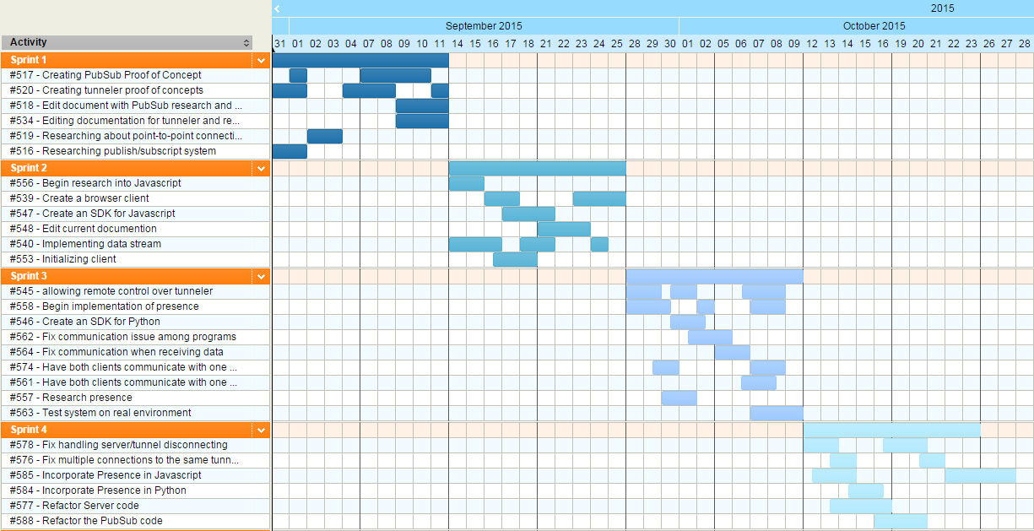
Project Management

Slide 4
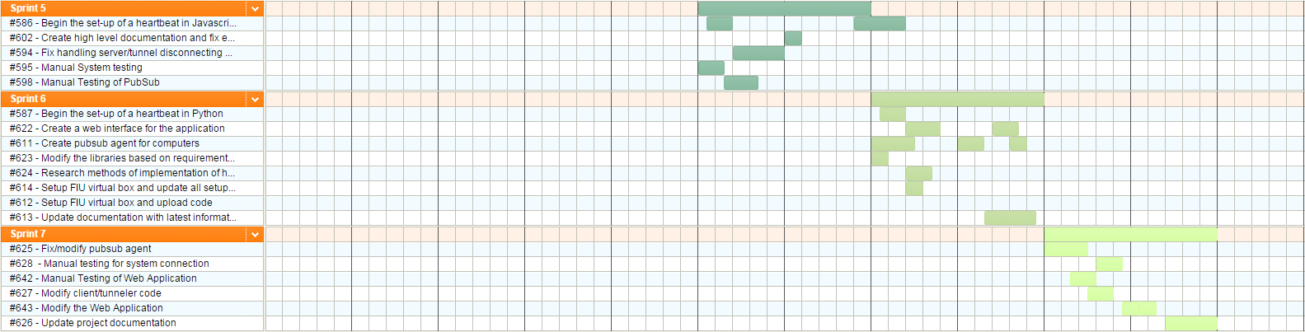
Project Management

Slide 5
Requirements
Notes:
FIU-SCIS-Senior-Projects

Slide 6
Requirements User Stories
Tunneler | Pubsub
#520 - Creating tunneler proof of concepts #540 - Implementing data stream #553 - Initializing client #545 - allowing remote control over tunneler #562 - Fix communication issue among programs #564 - Fix communication when receiving data #563 - Test system on real environment #578 - Fix handling server/tunnel disconnecting #611 - Create pubsub agent for computers #625 - Fix/modify pubsub agent #627 - Modify client/tunneler code | #517 - Creating PubSub Proof of Concept #539 - Create a browser client #547 - Create an SDK for Javascript #558 - Begin implementation of presence #546 - Create an SDK for Python #574 - Have both clients communicate with one another, using the libraries #586 - Begin the set-up of a heartbeat in Javascript #622 - Create a web interface for the application #643 - Modify the Web Application #642 - Manual Testing of Web Application

Slide 7
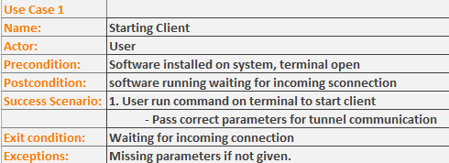
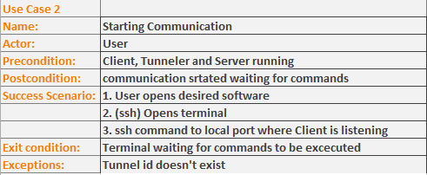
Requirements Use Case

Slide 8
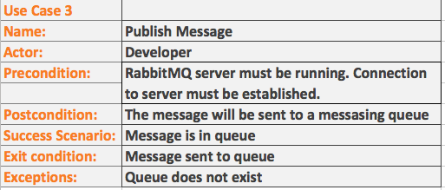
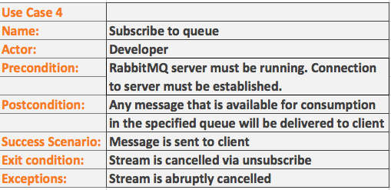
Requirements Use Case

Slide 9
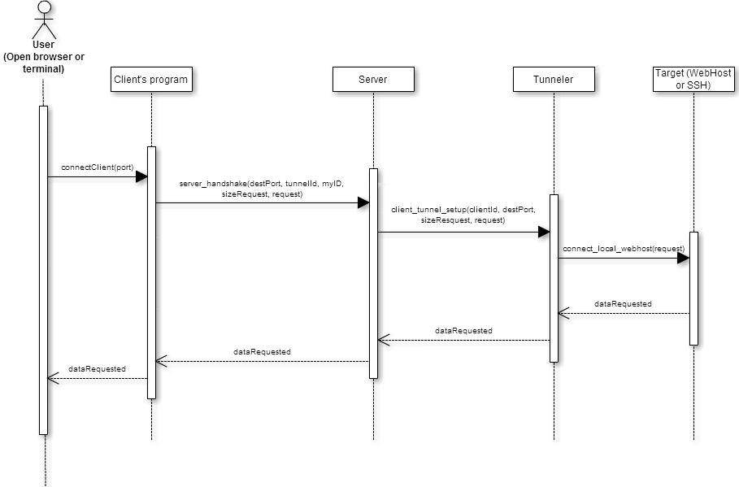
Requirements Sequence Diagrams
Use Case 2

Slide 10
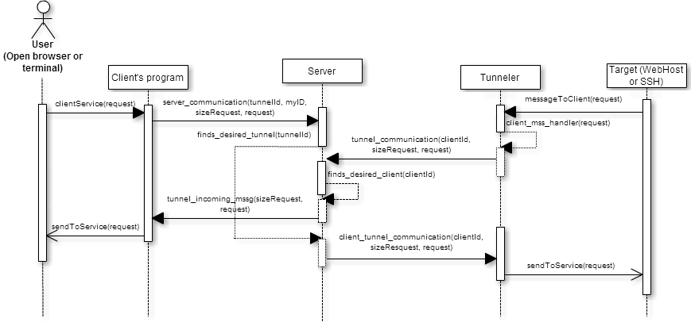
Requirements Sequence Diagrams
Use Case 2 - Connection already established
Communication flow

Slide 11
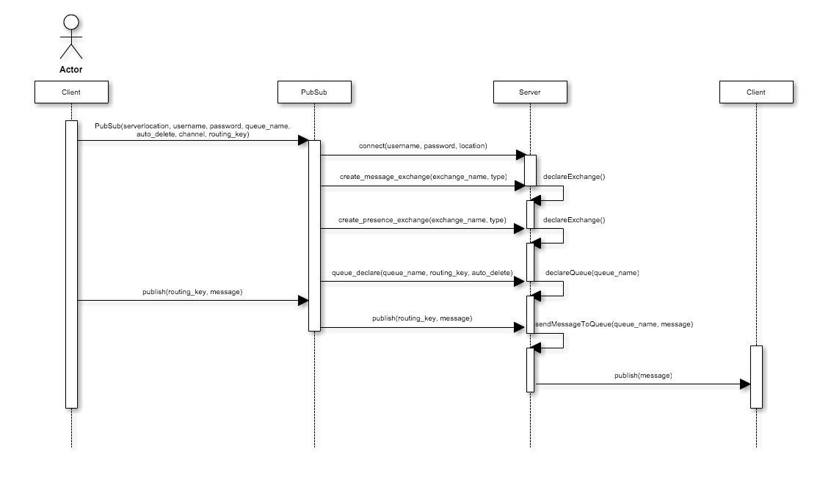
Requirements Sequence Diagrams
Use Case 3

Slide 12
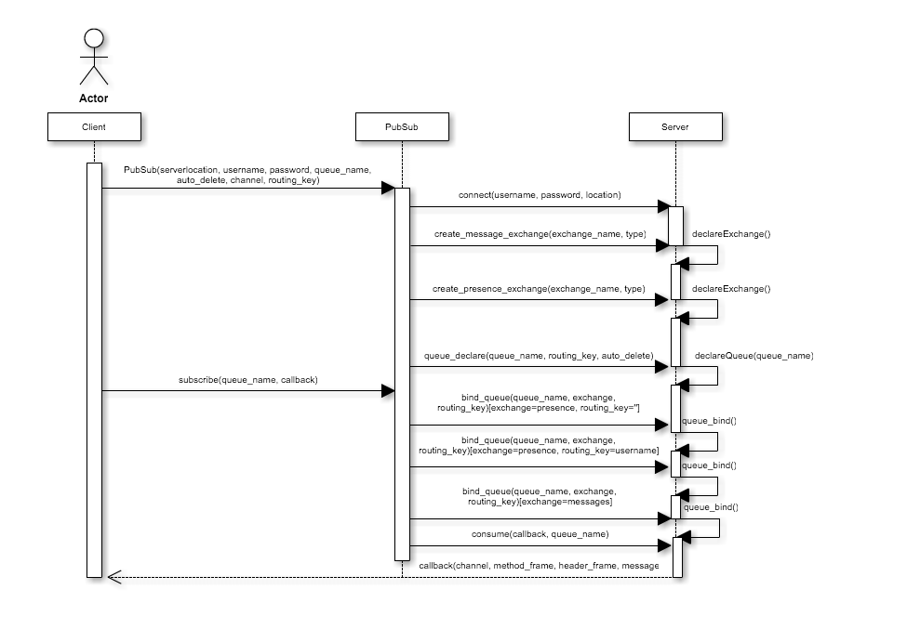
Requirements Sequence Diagrams
Use Case 4

Slide 13
System Design
Notes:
FIU-SCIS-Senior-Projects

Slide 14
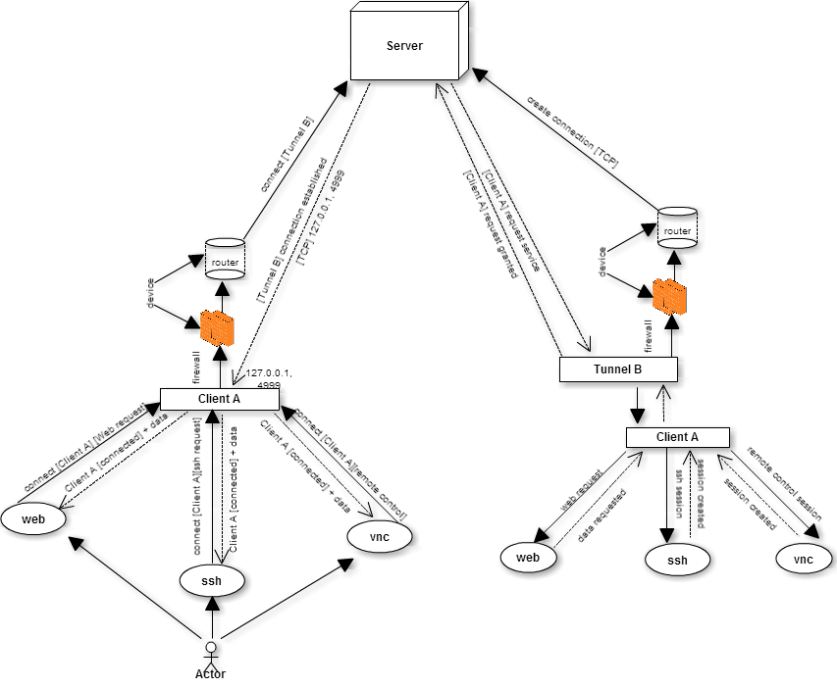
System Decomposition
Tunneler

Slide 15
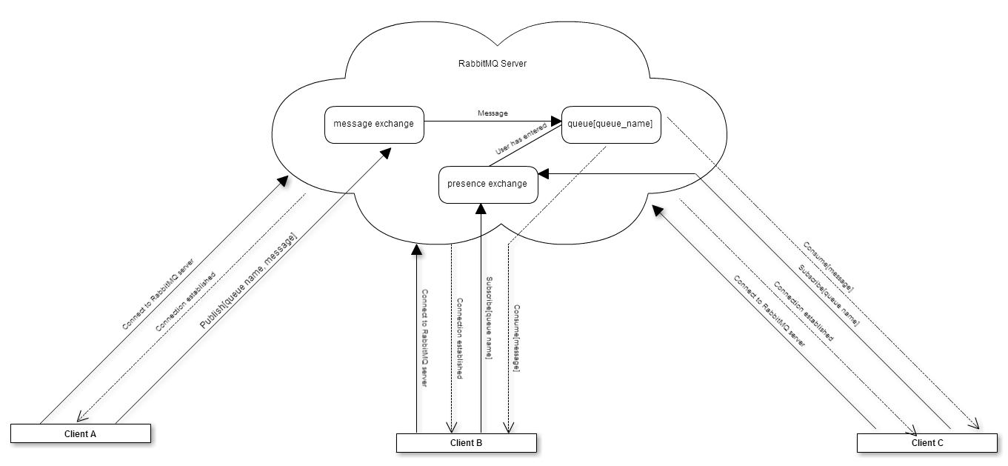
System Decomposition
PubSub

Slide 16
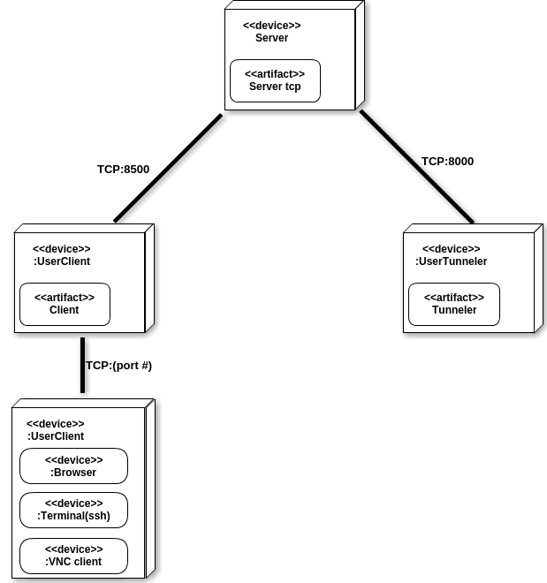
System Deployment
Tunneler

Slide 17
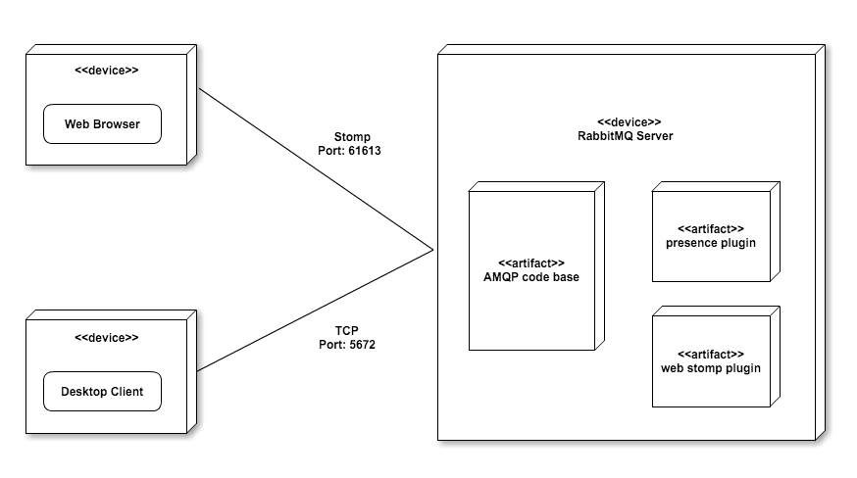
System Deployment
PubSub

Slide 18
Security/Privacy
Notes:
FIU-SCIS-Senior-Projects

Slide 19
Security/Privicy
Tunneler:
Client/Server/Tunnel communication uses TCP connection
Communications requires to know tunnelId and credentials for desired software to log in for example ssh or remote control (vnc) credentials

Slide 20
Security/Privacy
PubSub:
In order to establish a connection to the server, user credentials must be passed
Due to the fact that this service depends on RabbitMQ, SSL authentication is possible
Further, queues can be automatically deleted, exclusive (limiting who can consume messages on a queue)

Slide 21
Detailed Design
Notes:
FIU-SCIS-Senior-Projects

Slide 22
Design pattern
Relaying
peer-2-peer communication through a server using TCP or UDP connections.
Publish & Subscribe
subscriber subscribes to a queue by expressing interest in messages enqueued to that queue and by using subject-or content-base rule as a filter.
Notes:
Running in a separate thread
Every time there is an active socket ready to read from ACTIVE_SOCKETS it will be added to a queue which will be taken care by different threads to process the information

Slide 23
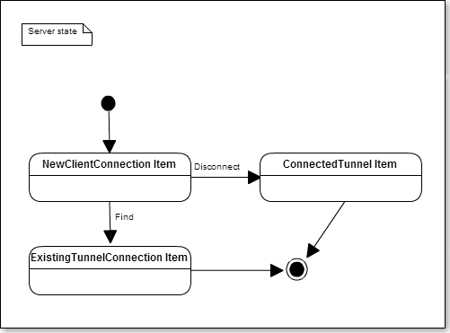
State Machine
Tunneler: server state machine when receiving a new Client connection
Notes:
Running in a separate thread
Every time there is an active socket ready to read from ACTIVE_SOCKETS it will be added to a queue which will be taken care by different threads to process the information

Slide 24
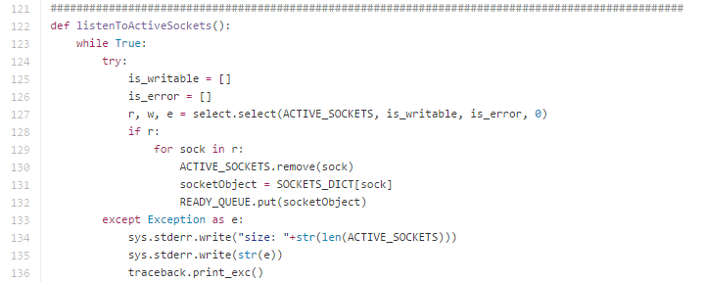
Main Algorithm
Tunneler:
Notes:
Running in a separate thread
Every time there is an active socket ready to read from ACTIVE_SOCKETS it will be added to a queue which will be taken care by different threads to process the information

Slide 25
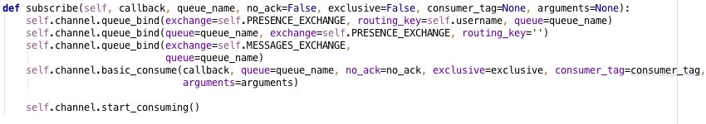
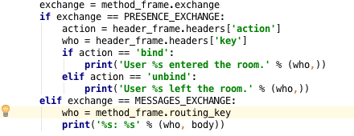
Main Algorithm
PubSub:
Notes:
Running in a separate thread
Every time there is an active socket ready to read from ACTIVE_SOCKETS it will be added to a queue which will be taken care by different threads to process the information

Slide 26
Testing
Sunny day
Rainy day
Identifier | ST06_ServerConnectionHandlingAfterFix
Purpose | Disconnecting client or tunnel while communication through server
Setup | established connection and communication in progress (vnc)
Input | vnc connection establish among clients than tunnel disconnects
Expected result | server catches the disconnection and closes all connections related with tunnel
Result | as expected.
Identifier | ST20_startigSSHsession
Purpose | Ensure ssh session starts correctly
Setup | start pubsub agent and send command to connect using ssh
Input | from web connect using ssh
Expected result | services started/ terminal with ssh session started
Result | as expected

Slide 27
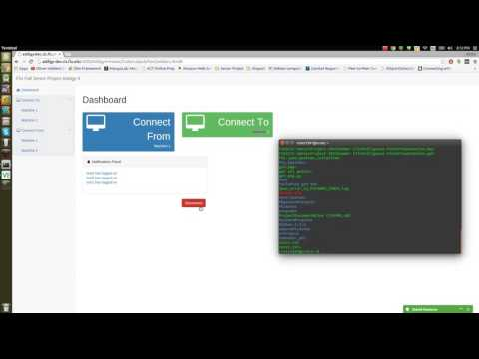
High-level demo
A demo of all use cases together.
Enjoy!

